Slide 1
Programming with the Microsoft Graph API
Notes:
This module introduces the Microsoft Graph API and explains how this powerful library abstracts away the divisions between Azure Active Directory, Exchange Online, SharePoint Online and OneDrive to create a single, unified API for general application development. Students will learn how to program against the Microsoft Graph API in an SPFX Web Part using both the AadHttpClient class and the MSGraphClient class. The module also explains why it’s necessary to add API permission request into the package-solution.json file for an SPFX solution and how to grant tenant-level API permissions in the SharePoint Admin Center. Along the way, students will learn how to program the Microsoft Graph API to view and create users in Azure Active Directory and to read and send email messages and calendar events using an Exchange inbox.

Slide 2
Agenda
Overview of Microsoft Graph API
Constructing URLs for the Microsoft Graph API
Developing Applications with the Microsoft Graph API
Programming SPFx Webparts using MSGraphClient
Granting Microsoft Graph API Permissions

Slide 3
Microsoft Released Office 365 APIs in 2014
Office 365 APIs created for accessing data in Office 365
Implemented as RESTful services based on ODATA version 4.0
Provides authentication and authorization based on OAuth 2.0
Provides extra authentication support for OpenID Connect
Open standards provide wide range of accessibility
Many choices for tools, languages and development platforms
Microsoft has created Office 365 SDKs for specific platforms
Office 365 APIs set the stage for the Microsoft Graph API
Microsoft Graph API created to simplify accessing Office 365
Azure API
Office 365 APIs – Preview release in Q4 of 2014
Azure Graph API
user management
General
Exchange
SharePoint
Discovery
API
Mail
API
Events
API
Contacts
API
Files
API

Slide 4
Office 365 API Endpoint in Initial Release
Azure Endpoints
Azure Graph API
Office 365 API Endpoints
Outlook service
OneDrive for Business Service
SharePoint Files Service
Discovery Services
Discovery Service
https://api.office.com/discovery/v1.0/me
Azure AD Data
Users
Groups
Azure Active Directory Graph API
https://graph.windows.net/CptClassroom1.onMicrosoft.com
Your
Office 365
Application
Outlook Data
Mail
Calendar
Contacts
Outlook Service
https://outlook.office365.com/api/v1.0/
OneDrive for Business Service
https://myTenant-my.SharePoint.com/personal/TedP/_api/v1.0/Files
SharePoint Data
OneDrive Files
Team Site Files
SharePoint Files Service
https://myTenant.SharePoint.com/_api/v1.0/Files

Slide 5
The Microsoft Graph API
Designed as a single, more-comprehensive service
Abstracts away divisions between AD, Exchange and SharePoint
No need to discover endpoints using the Discovery Service
You can acquire and cache a single access token per user
Azure AD Data
Users
Groups
Your
Office 365
Application
Outlook Data
Mail
Calendar
Contacts
Microsoft Graph API
https://graph.Microsoft.com
SharePoint Data
OneDrive Files
Team Site Files

Slide 6
What Does It Do?
Single resource that proxies multiple Microsoft services
Allows for easy traversal of objects and relationships
Simplifies token acquisition and management
Eliminates the need to traditional discovery
It does this by using "me" and "myorganization"

Slide 7
Universal Access
Direct REST API
Any platform
Any language
Any framework
Native SDKs
Utilize framework & platform specific implementations
Abstracts the details of building & processing requests over HTTP
.NET, iOS, Android, PhP, Ruby, JavaScript, etc.

Slide 8
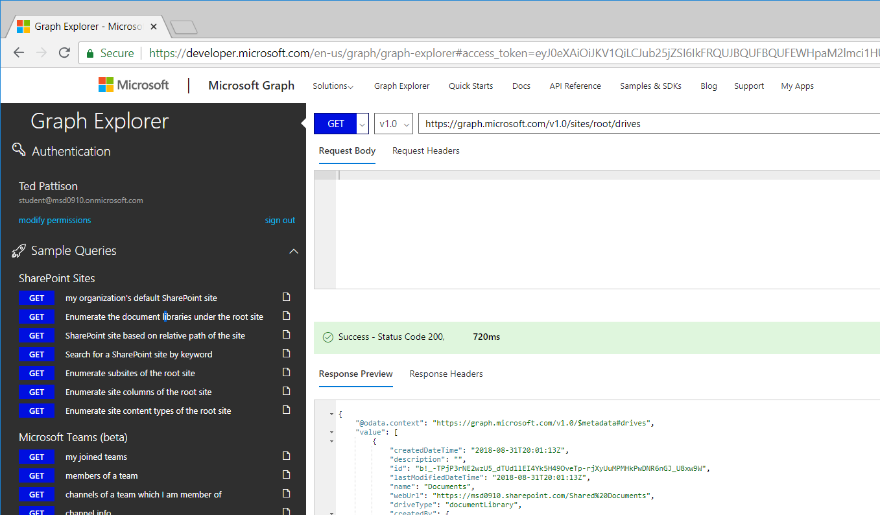
The Graph Explorer
Graph Explorer used to execute calls into Microsoft Graph API
Great place to discover what he API can do
https://developer.microsoft.com/en-us/graph/graph-explorer

Slide 9
Agenda
Overview of Microsoft Graph API
Constructing URLs for the Microsoft Graph API
Developing Applications with the Microsoft Graph API
Programming SPFx Webparts using MSGraphClient
Granting Microsoft Graph API Permissions

Slide 10
Calling the Graph API
https://graph.microsoft.com
/{version}
/{resource}
/{id}
/{property}
?{query-parameters}
HTTP verbs dictate the request intent: GET | POST | PATCH | PUT | DELETE
Version: /v1.0 or /beta
Resource: /users, /groups, /sites, /drives, /devices, more…
Member from collection: /users/AAA
Property: /users/AAA/department
Traverse to related resources via navigations: /users/AAA/events
Query parameters: /users/AAA/events?$top=5
Format results: $select | $orderby
Control results: $filter | $expand
Paging: $top | $skip | $skiptoken

Slide 11
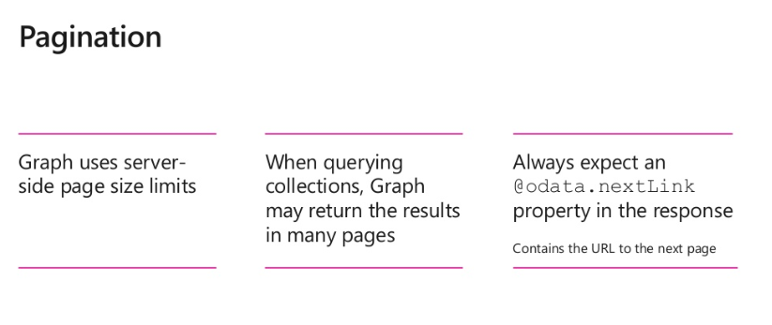

Slide 12
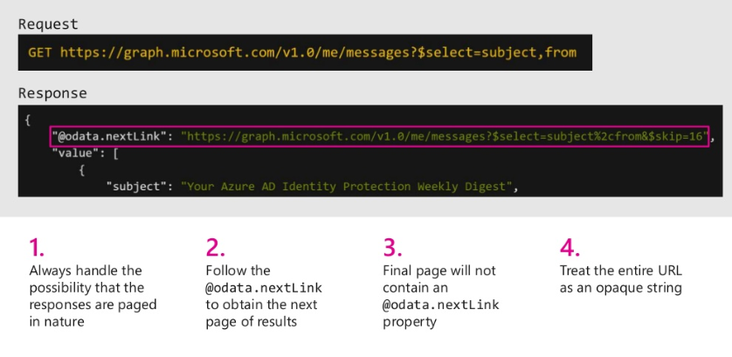

Slide 13
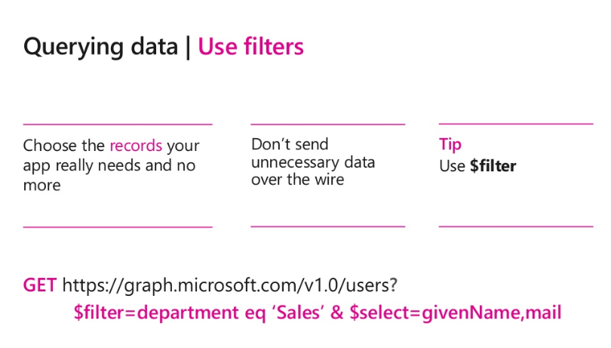

Slide 14
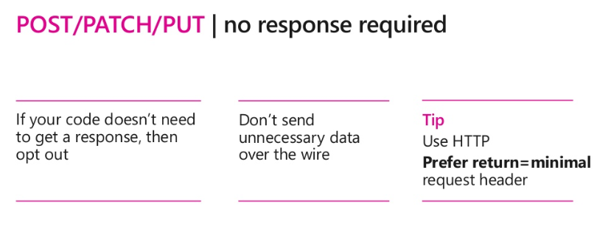

Slide 15
- User, group and organizational
Data
Microsoft Teams API - preview
Project Rome API - preview
SharePoint Sites API – GA
OneNote API – GA
Planner API – GA
One endpoint
One token
All users
Your app
https://graph.microsoft.com
Users
Groups
Excel
Outlook
Calendar
OneNote
Teams
Planner
Intune
Azure AD
SharePoint

Slide 16

With Microsoft Graph
GET: /users/JeanLuc
{
"displayName": "JeanLuc Picard",
"jobTitle": “Captain",
}
GET: /users/JeanLuc/photo/…
{}
GET: /users/JeanLuc/manager
{"displayName": "Starfleet Admiral", …}
GET: /users/JeanLuc/directReports
"value" : [
{"displayName": "Riker", …},
{"displayName": "Worf", …},
]
GET: /me/memberOf/…
"value" : [
{"displayName": "Starfleet engineering", …},
{"displayName": "Beaming", …},
]
Get the user profile
Admiral
manager
Groups
memberOf
JeanLuc
directReports
Riker
Worf
Data

Slide 17

With Microsoft Graph
GET /me/drive/root/…
"value" : [
{"name": "proposal.pptx",… },
{"name": "forecast.xlsx",… }
]
GET /drives/items/{id}/workbook
GET /me/messages
GET /me/events
GET /me/contacts
GET /me/onenote/notebooks
GET /me/planner/tasks
GET /me/devices
GET /sites:/teams/opg:/
GET /sites:/teams/opg:/lists
GET /groups/{id}/conversations
`
Get content for email, calendar, files, tasks, sites, notes & more
Documents
Calendar
Sites
Tasks
Email
Meetings
Contacts

Slide 18

With Microsoft Graph
GET /me/insights/trending
"value" : [
{"name": "presentation.pptx", …},
{"name": "forecast.xlsx", …}
]
GET /me/drive/recent
"value" : [
{"name": "guidelines.pptx", …},
{"name": "budget.xlsx", …}
]
GET people/?$search="topic: planning"
"value" : [
{"displayName": "Data", …},
{"displayName": "Worf", …},
]
POST: /me/findMeetingTimes
{
"attendees": [
{
"type": "required",
"emailAddress": {
"address": "riker@contoso.com"
}
],
"meetingDuration": "2h"
}
Get insights based on activities
Out of office
Trending Documents
Find me the best time to meet Ana
Search people based on topics
People I’m working with
Recent Documents

Slide 19
Read data from existing SharePoint site
GET https://graph.microsoft.com/beta/sites/ {siteId}/lists/{listId}/items?expand=columnSet
{ "value":[ {
"createdBy": { "user" : {"id":"d54e4cdd-d2ca-4c39-bfa5-35895bca12f0","displayName":"John"}},
"createdDateTime":"2017-09-20T08:16:21Z",
"eTag":"1610ac6a-24f6-4458-9733-1e5977c63caa,1",
"id":"1610ac6a-24f6-4458-9733-1e5977c63caa",
"lastModifiedBy":{"user":{"id":"d54e4cdd-d2ca-4c39-bfa5-35895bca12f0","displayName":"John"}},
"lastModifiedDateTime":"2017-09-0T08:16:21Z",
"webUrl":"https://site.sharepoint.com/sites/mysite/Lists/mytasks/1_.000",
"listItemId":1,
"columnSet":{
"Title":"Project Upgrade: Use the Microsoft Graph",
"Description":"Set up group for new technologies.",
"id":"1",
...
} }]}
Notes:
No SDKs for SP operations

Slide 20
OneDrive + Excel Services
GET https://graph.microsoft.com/v1.0/me/drive/ root/search(q='.xlsx')?select=name,id,webUrl
GET https://graph.microsoft.com/1.0/me/drive/
items/<id>/workbook/worksheets
GET https://graph.microsoft.com/beta/me/drive/
items/{itemId}/workbook/worksheets('Time’)/ range(address='a2:d4')

Slide 21
Update Excel Timesheet Data
PATCH https://graph.microsoft.com/beta/me/drive/
items/{itemId}/workbook/worksheets('Sheet1')/ range(address='a2:b2')
{
"values": [ ["September", "200.0"] ],
"valueTypes": [ ["String", "Double"] ],
}

Slide 22
New Capabilities
Traversal of relationships
Query parameters
Batching - preview
Notifications - users & groups - preview
Track changes - GA
Extensions - GA

Slide 23
Agenda
Overview of Microsoft Graph API
Constructing URLs for the Microsoft Graph API
Developing Applications with the Microsoft Graph API
Programming SPFx Webparts using MSGraphClient
Granting Microsoft Graph API Permissions

Slide 24
Microsoft Graph JavaScript SDK
Microsoft Graph is accessible via REST API & various SDKs
Client-side solutions can leverage the JavaScript SDK
https://github.com/microsoftgraph/msgraph-sdk-javascript
Requires initialization with an Azure AD provided OAuth2 access token to create the client
Notes:
Let’s review from the previous section

Slide 25
Initializing the Microsoft Graph JS SDK
var client = MicrosoftGraph.Client.init({
authProvider: (done) => {
done(null, access_token);
}
});
client
.api('/me')
.get((err, res) => {
console.log(res);
});

Slide 26
Microsoft Graph TypeScript Type Declarations
Use the Microsoft Graph JavaScript SDK in TypeScript applications
TypeScript type declarations introduce strong types and documentation to client-side projects
https://github.com/microsoftgraph/msgraph-typescript-typings

Slide 27
Microsoft Graph TypeScript Type Declarations
import * as MicrosoftGraph from '@microsoft/microsoft-graph-types';
// init Microsoft Graph client
client
.api('/me')
.get((error: any, user: MicrosoftGraph.User, rawResponse?: any) => {
console.log('name: ', user.displayName);
console.log('email: ', user.displmailayName);
console.log('phone: ', user.businessPhones[0]);
});
});

Slide 28
Agenda
Overview of Microsoft Graph API
Constructing URLs for the Microsoft Graph API
Developing Applications with the Microsoft Graph API
Programming SPFx Webparts using MSGraphClient
Granting Microsoft Graph API Permissions

Slide 29
SharePoint Online User Already Authenticated
Users in SharePoint Online & Office 365 are already authenticated
SharePoint Online has same Azure AD dependency as Microsoft Graph
Users login to Office 365 with their Work & School account (Azure AD)
Calls to the Microsoft Graph are proxied through SharePoint Online
Eliminates the need for creation of a separate Azure AD application
Does not bypass any permission / scope requirements
Can only access business entities, not consumer entities

Slide 30
Calling Services from Client-side Code
Calling a secured service requires the acquisition of token
Authenticate and get authorized in Azure AD application
Interactive login & programmatic acquisition of access token
Client-side components cannot do the same
Components cannot securely do this across domains seamlessly
Can’t store application ID’s and secrets client side
Require an authentication prompt with a popup or redirection

Slide 31
SPFx Includes Microsoft Graph Client
MSGraphClient: Microsoft Graph Client fpr SPFx
Abstracts the token acquisition from the SPFx development
Wraps the Microsoft Graph JavaScript SDK line
let graphClient: MSGraphClient = this.context.serviceScope.consume(MSGraphClient.serviceKey);

Slide 32
SPFx Proxy Calls through Existing Application
SharePoint Online already has an Azure AD application
Client-side solutions in SharePoint Online call the SharePoint REST API in the same domain
No extra authentication required
Provided these tenants have granted the necessary scopes, SharePoint will call the Microsoft Graph
Responses from the Microsoft Graph are returned back to the client-side application
Permission requests to Azure AD applications
Only SharePoint Online tenant administrators can [grant|reject] permission requests
Approved permissions are available to all client-side solutions in a tenant

Slide 33
SPFx Solutions Declare Permission Requests
// package-solution.json
{
"$schema": "https://developer.microsoft.com/json-schemas/spfx-build/package-solution.schema.json",
"solution": {
"name": "ms-graph-sp-fx-client-side-solution",
"id": "dfb230b7-4f61-431f-9b65-a34e83922663",
"version": "1.0.0.0",
"includeClientSideAssets": true,
"webApiPermissionRequests": [
{ "resource": "Microsoft Graph", "scope": "User.ReadBasic.All” },
{ "resource": "Microsoft Graph", "scope": "Calendars.Read” },
{ "resource": "Microsoft Graph", "scope": "Tasks.Read” }
]
},
"paths": {
"zippedPackage": "solution/ms-graph-sp-fx.sppkg"
}
}

Slide 34
Agenda
Overview of Microsoft Graph API
Constructing URLs for the Microsoft Graph API
Developing Applications with the Microsoft Graph API
Programming SPFx Webparts using MSGraphClient
Granting Microsoft Graph API Permissions

Slide 35
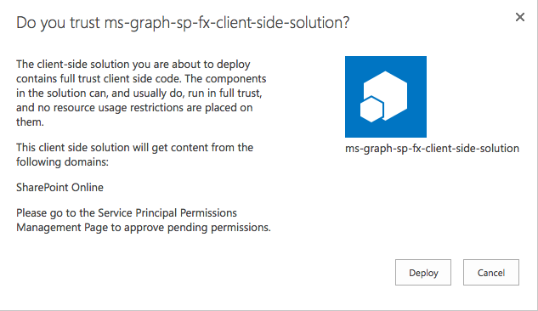
Add Package to SharePoint App Catalog
Extra note in dialog notifies of additional step required
While application can be installed in SharePoint sites, it does not have the permissions granted that it needs to access Azure AD protected resources

Slide 36
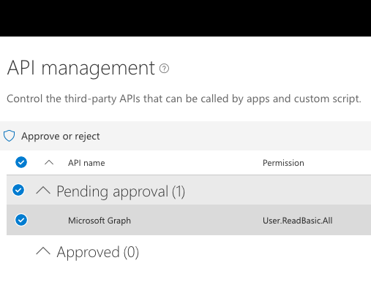
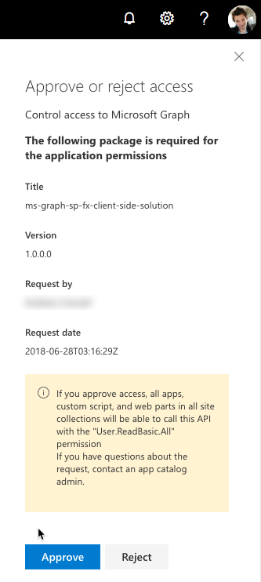
Approve / Reject with SharePoint Online API Management Page

Slide 37
Summary
Overview of Microsoft Graph API
Constructing URLs for the Microsoft Graph API
Developing Applications with the Microsoft Graph API
Programming SPFx Webparts using MSGraphClient
Granting Microsoft Graph API Permissions

Slide 38

With Microsoft Graph
Batching
POST /$batch
{
"requests": [{
"id": "1",
"url": "/me/drive/root/children",
"method": "POST",
"body": {
"name": "folder1",
"folder": {}
},
"headers": {
"content-type": "application/json"
}
}, {
"id": "2",
"url": "/me/drive/root/children/folder1",
"method": "GET",
"dependsOn": ["1"]
}, {
"id": "3",
"method": "GET",
"url": "/me/planner/tasks"
}, {
"id": "4",
"method": "GET",
"url": "/groups/{id}/events"
}
]
}
Use $batch to combine multiple requests in one call
Documents
Calendar
Sites
Tasks
Email
Meetings
Contacts

Slide 39
With Microsoft Graph
GET/me/mailFolders/{id}/messages/delta
"@odata.deltalink":"me/mailfolders('AA')/messages/delta?$deltatoken=BB",
"value" : […]
POST /subscriptions
{
"changeType": "created,updated",
"notificationUrl": "https://app.net/callback",
"resource": "/me/mailfolders('AA')/messages",
}
GET/me/mailFolders/{id}/messages/delta ?$deltatoken=BB"
"value" : […]
Get notifications & track changes
Edited a file
Scheduled a new meeting
Got a new hire
Added a new member to a group
Got high important email

Slide 40
Extending the Graph
Open Extensions
GET /me/message/<id>/?$expand=extensions
{
"displayName": “JeanLuc",
"extensions": [
{
"extensionName": "Com.Contoso.Referral",
"companyName": "atwork",
"expirationDate": "2017-12-30T11",
"dealValue": 10,000
}
]
}
Schema extensions
POST /schemaExtensions
{
"id": "training_courses",
"targetTypes": [ "Group" ],
"properties": [
{
"name": "courseName",
"type": "String"
}…
]
}
GET /groups?$filter=courses/name eq Math101
Add extensions to user, group, mail & more
Customer referral email
Group: Math 101
Carlo’s son: Johnny
Favorite color: blue

